Slide 1
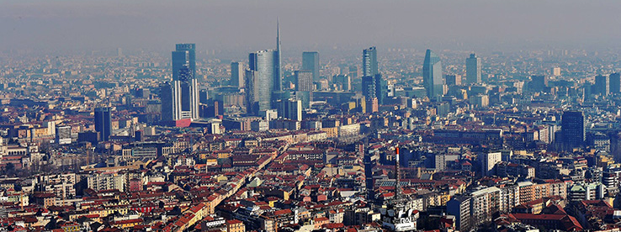
PowerEnJoy
A new way of doing car sharing

Slide 2

Topics
Problem analysis
Status of the market

Slide 3
Problem analysis
We manage to design and develop a digital management system for a car-sharing service that exclusively employs electric cars
Why electric cars only?
Because big cities are already experiencing high levels of pollution, and their citizens are looking for a new way to move that may be, at the same time, cheaper and green.

Slide 4
Problem analysis
The system will allow registered users to discover available cars nearby their current position
Registered users will be allowed to book a car for a limited time (1 hour)
Within this time, the user will be allowed to delete his/her reservation
The user will be asked to pay a fee of 1 euro if the reservation expires
After a reservation is concluded or expired, the reserved will become available for other users
The system will incentivize the virtuous behaviors of the users by means of applying discounts or fees in the appropriate contexts.

Slide 5
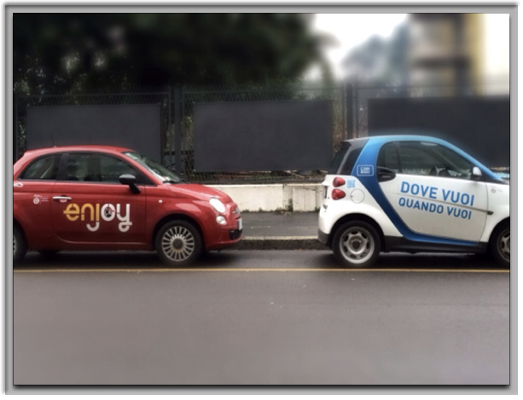
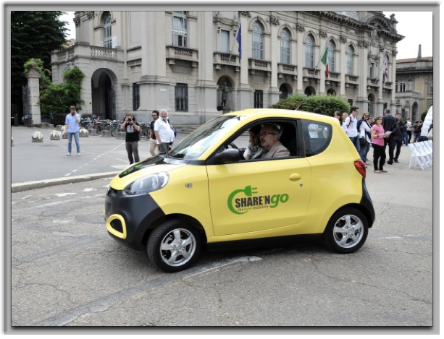
Status of the Market
Only in the city of Milan there are approximately:
6 car sharing services involving only vehicles with combustion engines
3 car sharing services involving only electric vehicles

Slide 6
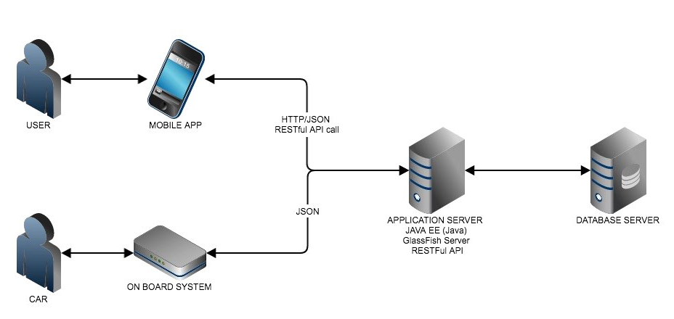
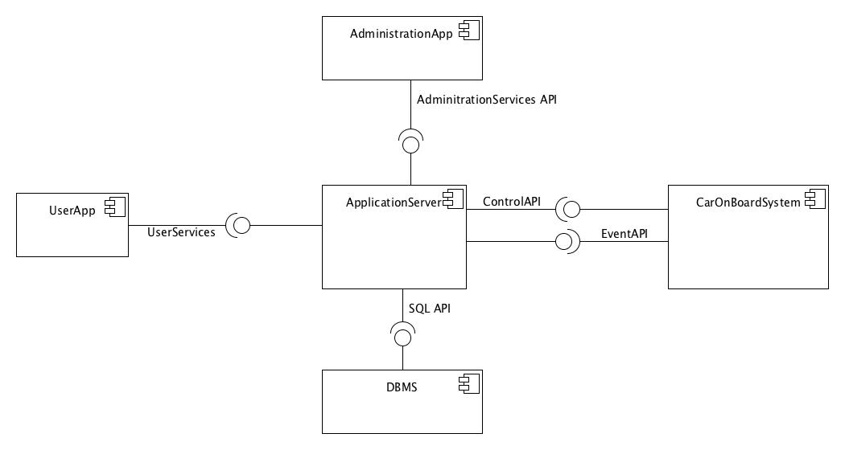
Architecture
High level overview
Mobile application: software component installed on the user’s device which renders the user interface and handles interactions with the user
Administration application: web application meant to provide all those functionalities required for the administration of the system
Car on board system: set of software components installed on the car’s system (provided by the manufacturer which handles car’s relevant sensors and commands coming from the application server
Application server: set of software components that handle the business logic of the system
Database server: set of software components which allows to store permanent data.

Slide 7
Architecture
High level overview
The PowerEnJoy system is designed with a modified MVC approach:
The Model is in the Business Manager
Multiple Controllers manage multiple aspects of the system
User Controller
Car Controller
Payment Manager
Administration Helper

Slide 8
Architecture
High level overview
The PowerEnJoy system is designed with a modified MVC approach:
The Customer View is implemented:
in the Mobile App
on the car system
The Administration View is offered by the server as a web application (thin client approach)

Slide 9
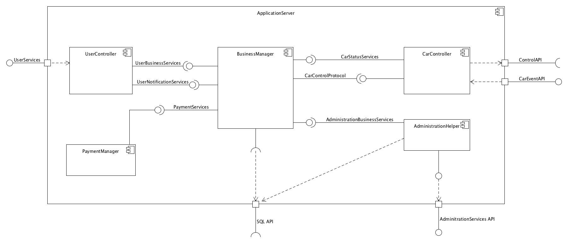
Application server
High level description

Slide 10
Application server
High level description
Exposes a RESTful API to the Mobile application to provide all the functionalities that a user might call directly or indirectly
Exposes a RESTful API to the Administration Web application to provide all the functionalities that the administration of the service needs.
Exposes a RESTful API to the Car on board system to allow it to notify events of interests from the the point of view of the business logic (i.e. car engine starts)
Forwards commands to the Cars by means of the software API provided by the Car on board system
Interacts directly with the Database server by means of the standard SQL interface (2011)

Slide 11
Application server
Components’ description
Business Manager: software component which handles the entire business logic of the system
User Controller: handles the bidirectional communication between the mobile applications and the application server.
Payment Manager: software component which handles all the interactions between the business logic and with third-part payment services (by now, PayPal is the only one supported)
AdministrationHelper: software components which handles all the requests coming from the administration’s web application (AdministrationServices API)
CarController: handles the bidirectional communication between the on board car system and the application server.

Slide 12
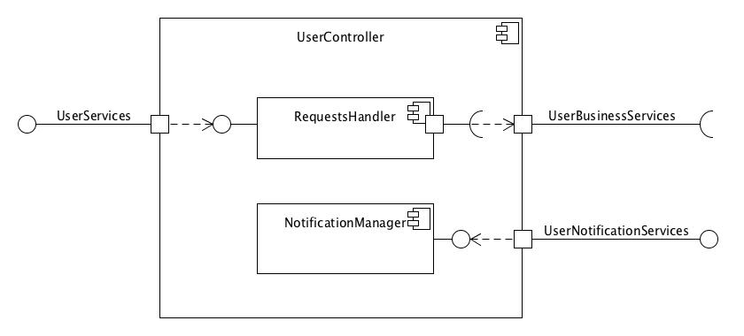
User Controller
High level description
Following the MVC paradigm, this controller performs checks on the incoming user requests
It also exposes an interface to provide means to forward notifications of various type to the user.

Slide 13
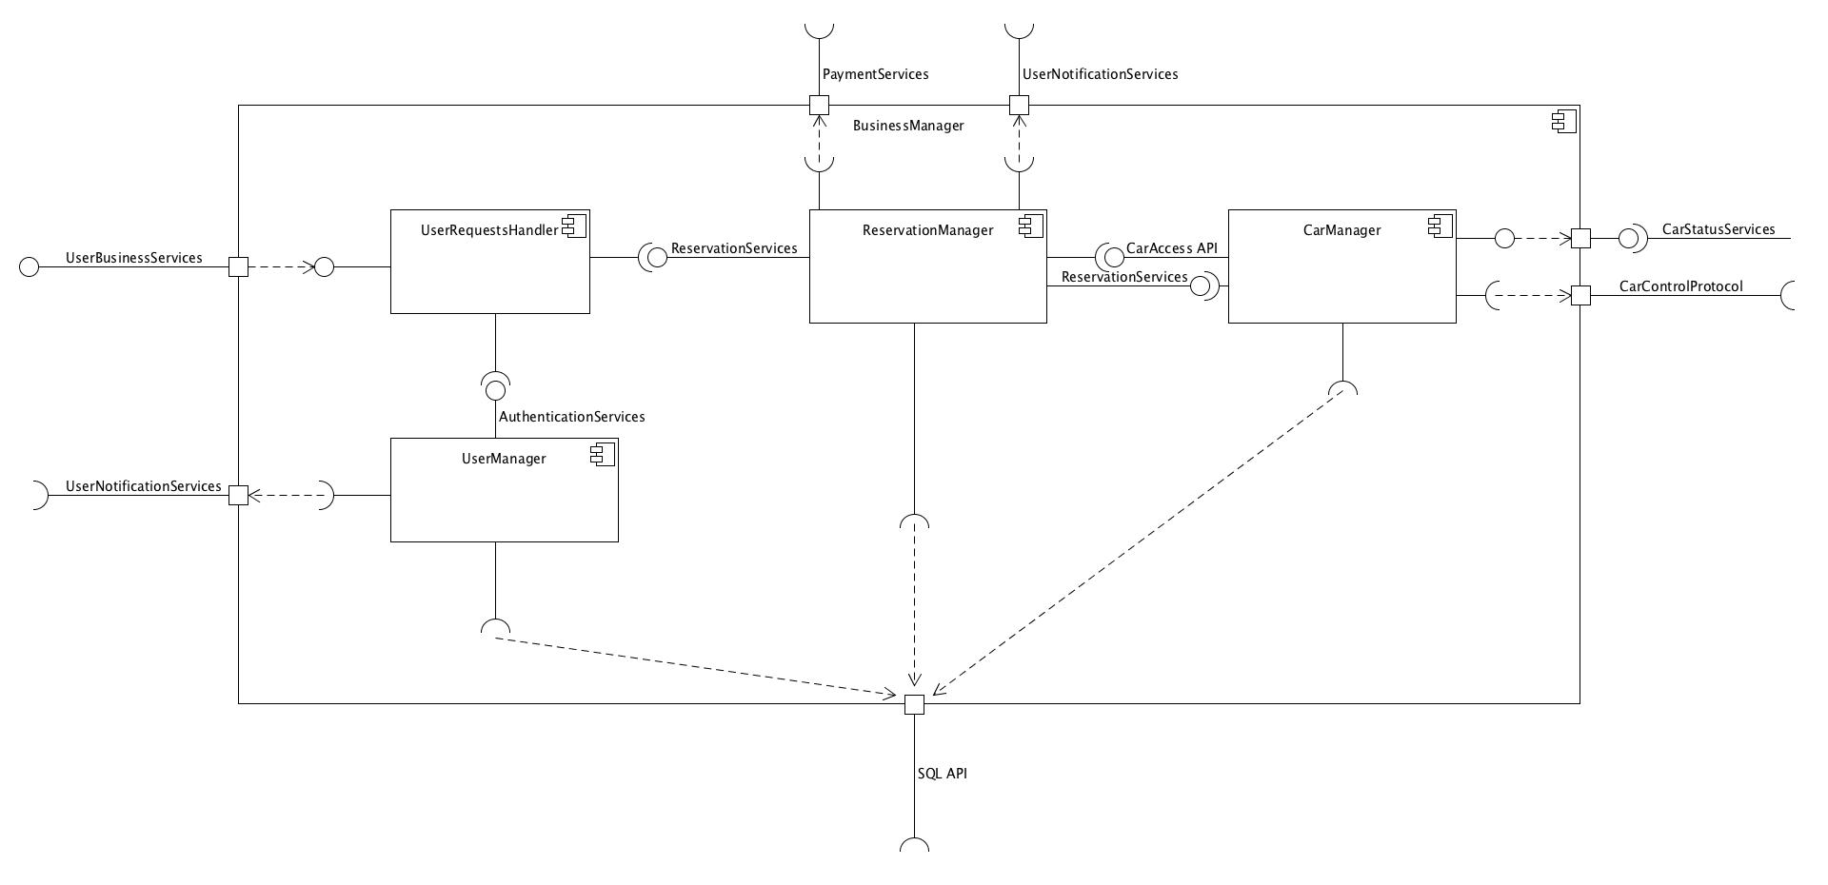
Business Manager
High level description

Slide 14
Business Manager
High level description
Exposes interfaces to provide all the business logic functionalities both to users and physical car.
Relies directly on the SQL interface to interact with the database services
Relies on the UserNotificationServices interface provided by the UserController to forward notifications to the users.
Relies on the CarControlProtocol interface provided by the CarController to forward commands to the cars.
Relies on PaymentServices provided by the Payment software component

Slide 15
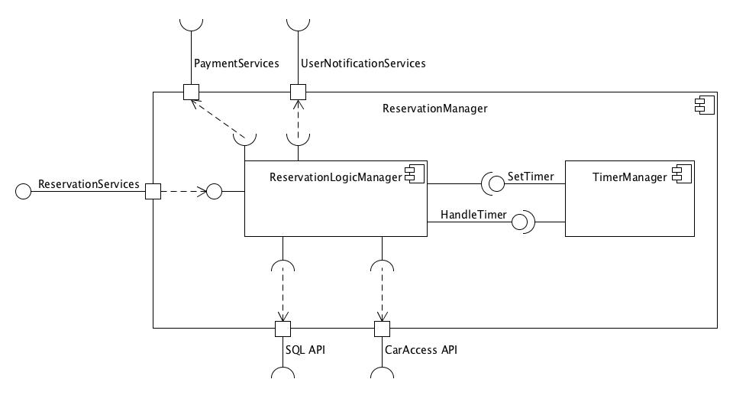
Reservation Manager
High level description
It Is one of the core software components of the business logic
The Reservation Manager is in charge of all reservation operations, including the computation of a reservation's cost.

Slide 16
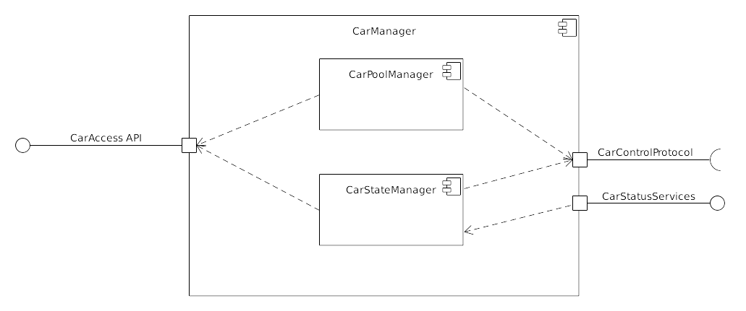
Architecture: the Car Manager
Part of the Business Manager
Performs all DB operations regarding:
Car state handling (Car State Manager)
Subscription or deletion of cars to the system (Car Pool Manager)
Answer queries on car sets issued by the user

Slide 17
The Car communication protocol
Cars will interact with the server’s Car Controller in the following ways:
Authentication to the server
Ordinary communication
Events: state changes originating from the car
Commands: state changes issued to the car by the server
Ordinary telemetry: regular messages to update the server about the car general condition (position, battery status...)

Slide 18
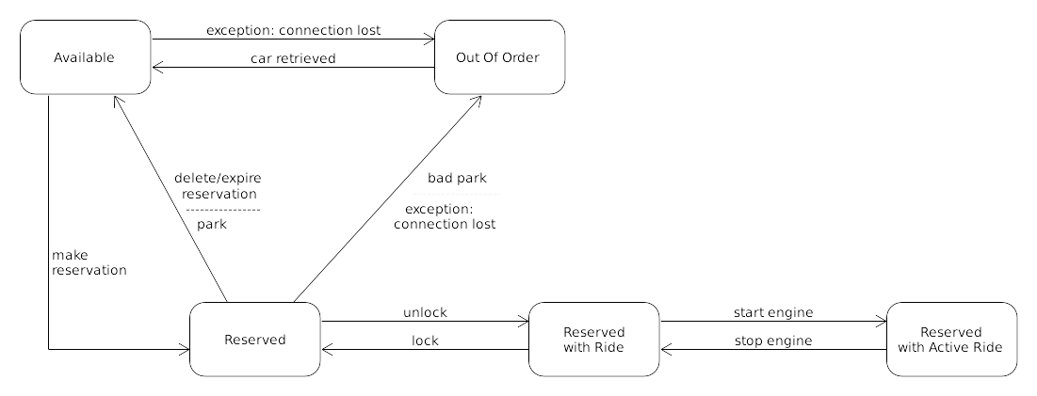
The Car as a FSM

Slide 19
The Car as a FSM
State changes issued by the server (commands):
Reserve: an available car becomes reserved
Free: a reserved car becomes available
Invalidate: a reserved car is parked in an unreachable spot and becomes Out Of Order
Unlock: the user has pressed the unlock button on their phone, the reserved car now is Reserved With Ride
Retrieve: an Out Of Order car has been retrieved by personnel and becomes available again

Slide 20
The Car as a FSM
State changes originating from the car (events):
Lock: the user has closed and locked the car door after a ride, the car state changes from Reserved With Ride to Reserved
Start engine: the car state changes from Reserved With Ride to Reserved With Active Ride
Stop engine: the car state changes from Reserved With Active Ride to Reserved With Ride

